Slide 1
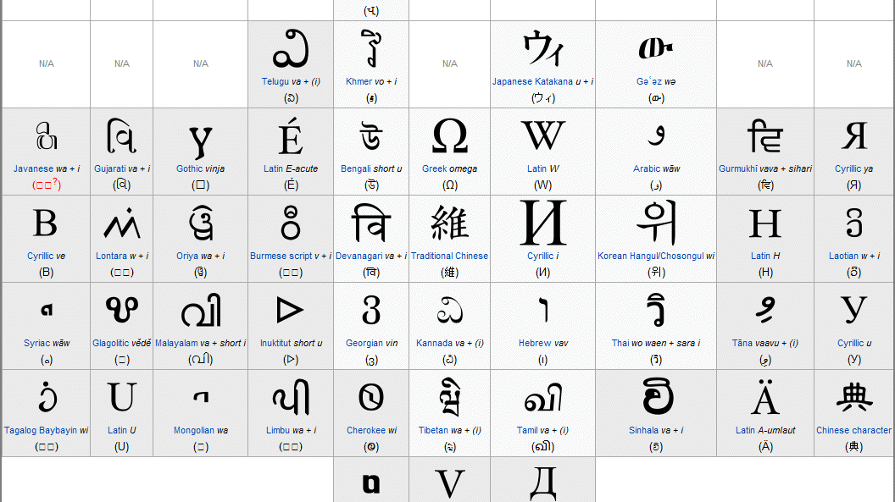
Wikipedia Web Traffic Project
Shreyak
Notes:
Good morning Every one my name is Shreyak and this is my wikipedia web traffic project

Slide 2
Goal – To forecast Web Traffic
Workflow
1 Data preparation
2 Exploratory Data Analysis (EDA)
3 Time Series approaches
Multiplicative model
Auto Regressive Integrated Moving Average (ARIMA)
Seasonal Autoregressive Integrated Moving Average(SARIMA)
Vector autoregression (VAR)
Seq2Seq (using LSTM)
4 Conclusion
Notes:
I just wanted to walk you through the work flow that I did for this project I started with data preparation then I did some EDA then I followed various modeling approaches.
multiplicative ,arima ,sarima vector autoregression and seq2seq

Slide 3
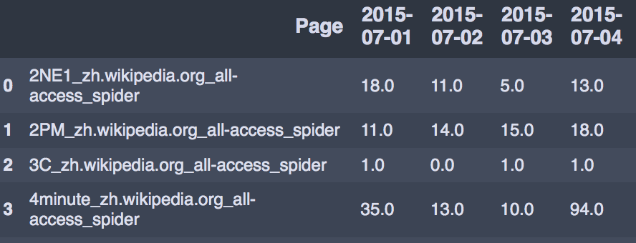
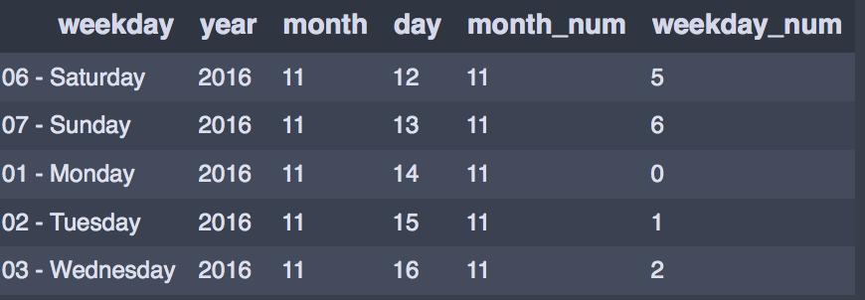
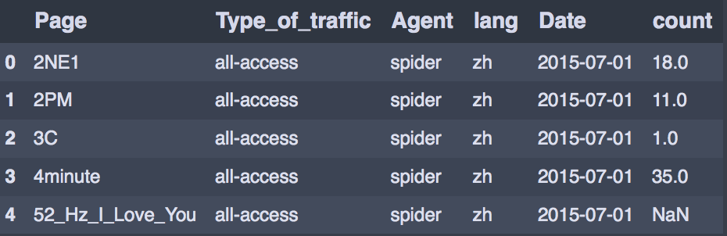
Data Preparation
MELT
Melt
Notes:
My data had each date as a separate column which made it very difficult to segregate specific counts for specific days so I melted the data in a way that date values were now in rows with their respective counts
I also broke down the data into weekday years months for further analysis

Slide 4
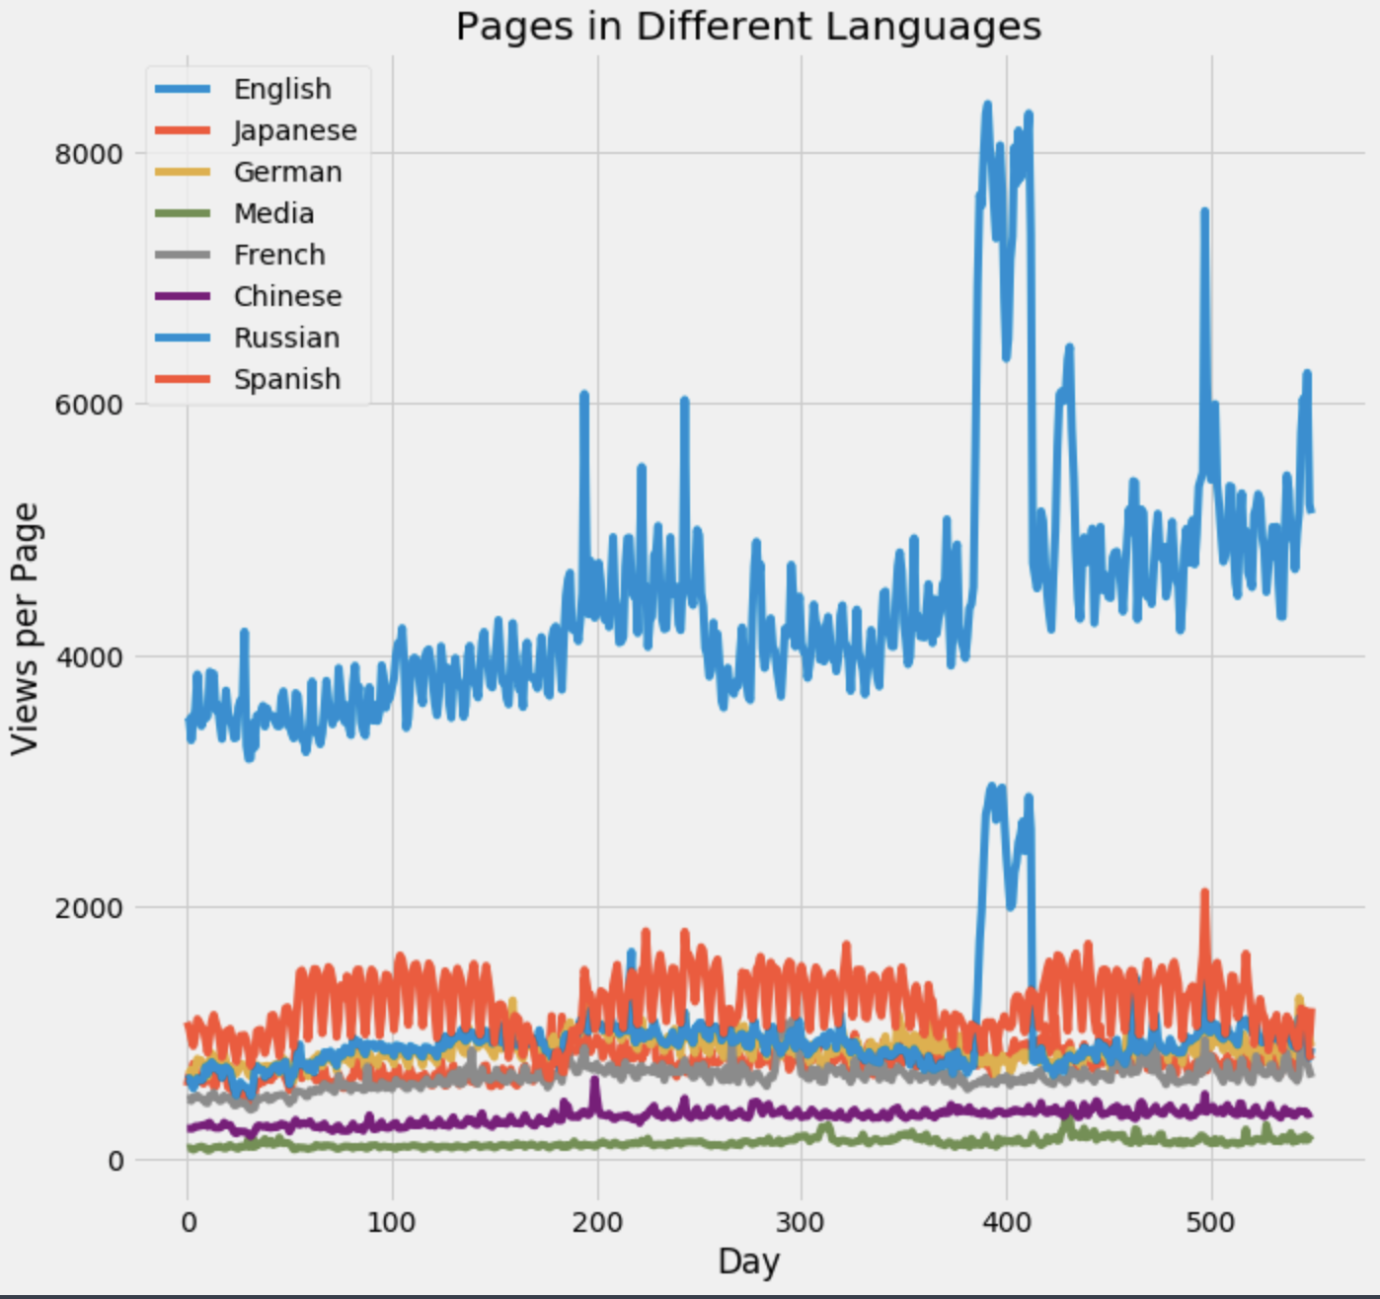
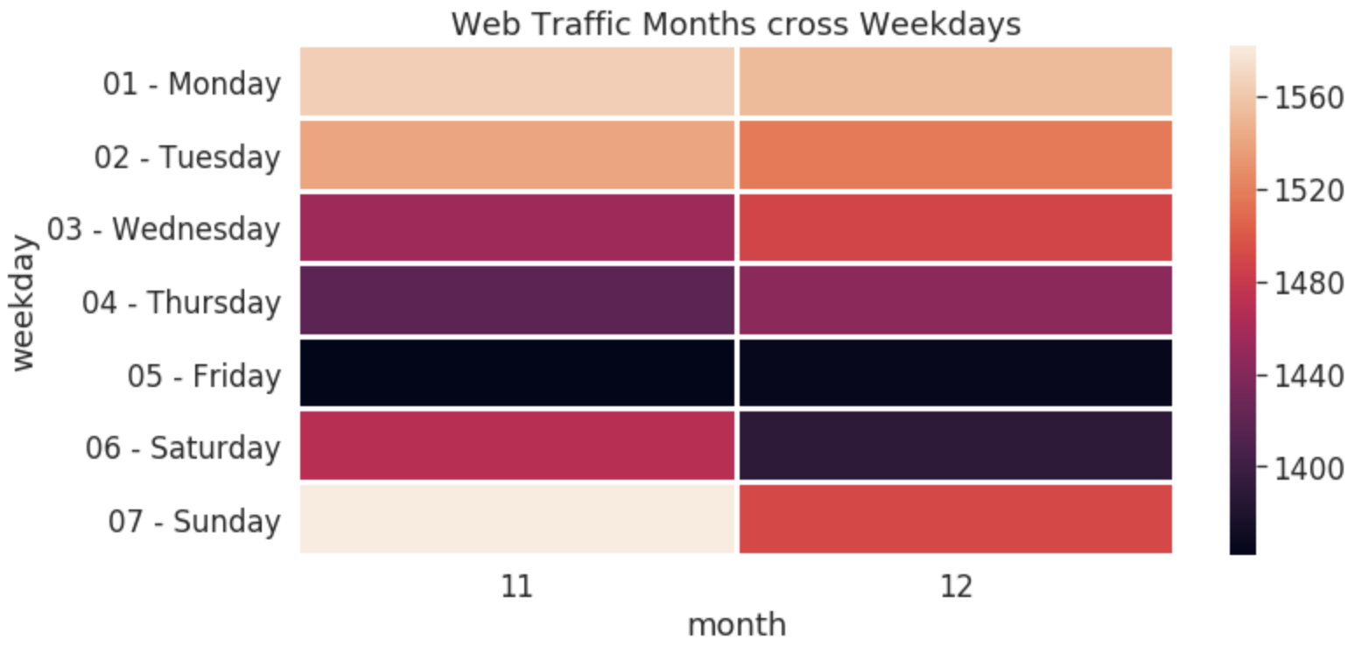
Exploratory Data Analysis (EDA)
Notes:
Here on the left is the chart showing all the languages over time , English shows a much higher number of views per page, as might be expected since Wikipedia is a US-based site.
The English and Russian plots show very large spikes around day 400 (around August 2016), with several more spikes in the English data later in 2016. My guess is that this is the effect of both the Summer Olympics in August and the election in the US.
The Spanish data is very interesting too. There is a clear periodic structure there, with a ~1 week fast period and what looks like a significant dip around every 6 months or so.
And on the right we have the web traffic by weekdays cross the months. In our data we can see there are less activity in Friday and Saturday for December and November. And the biggest traffic is on the period Monday - Wednesday.

Slide 5
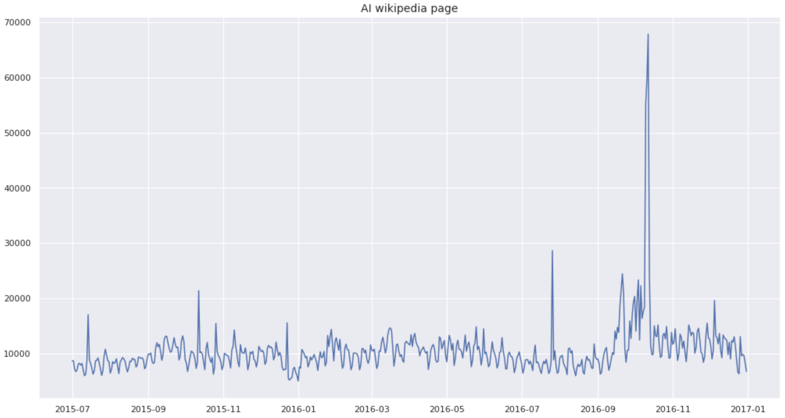
Model Building
Frame of Reference
Notes:
this is the AI Wikipedia page data we will use this page as a frame of reference as we will be forecasting using this data for our models

Slide 6
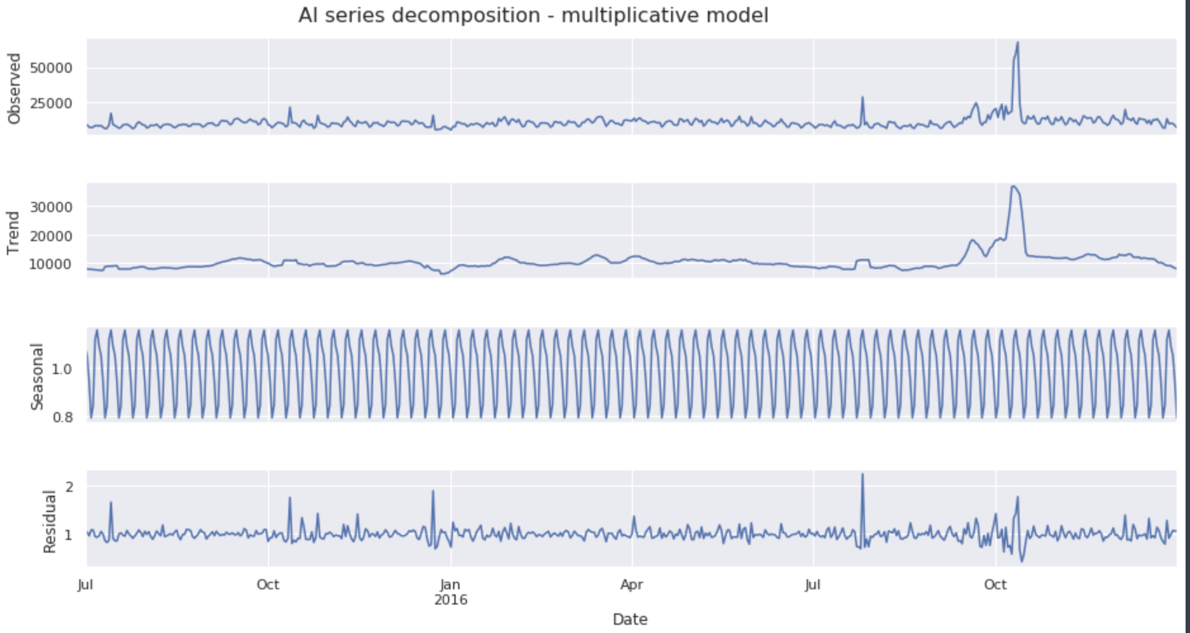
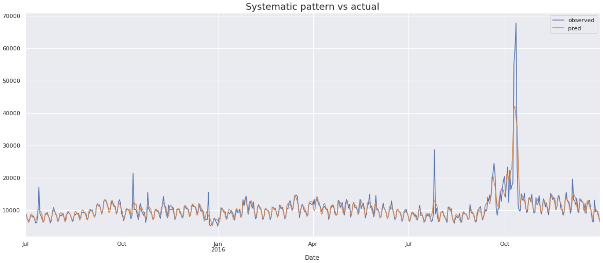
Multiplicative model
Notes:
So I started my model buling by using a multiplicative model I extracted the seasonality and trend component by decomposing this time series
With a smape of 8.5% I feel this model did a decent job although it didn’t cover the spikes but I feel it did a good job at covering variability

Slide 7
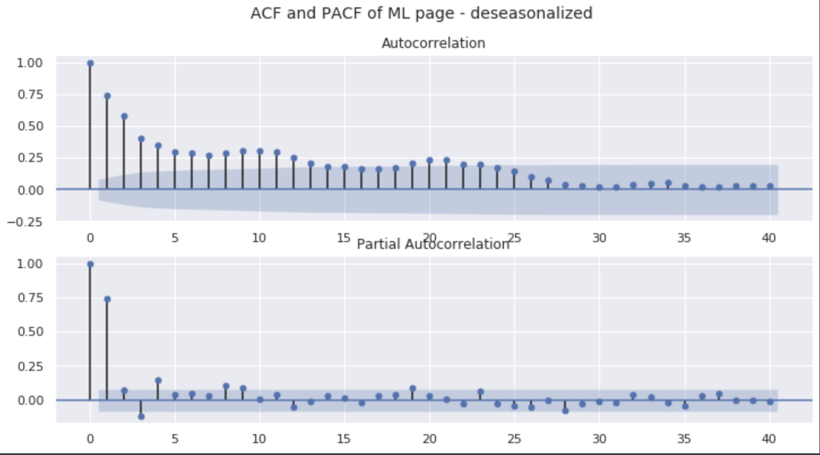
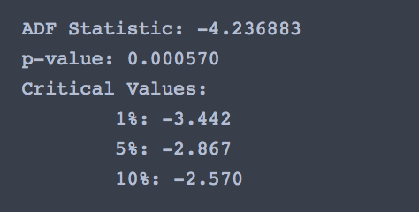
ARIMA
Stationarity check(ADF)
Notes:
Then I moved on to Arima I plotted the correlation plots for the deseasonlized data to find out the best lag order for our arima model then I did an ADF test to check for stationarity

Slide 8
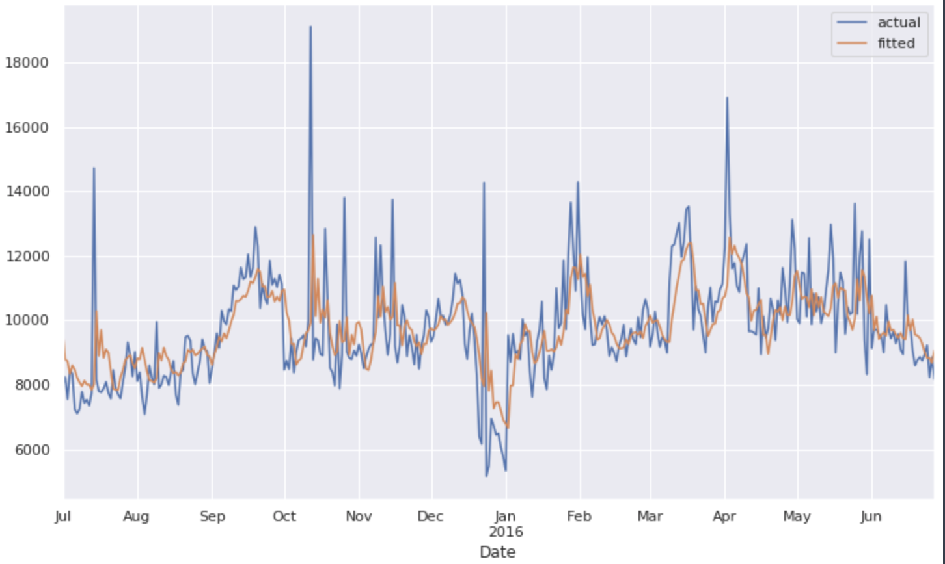
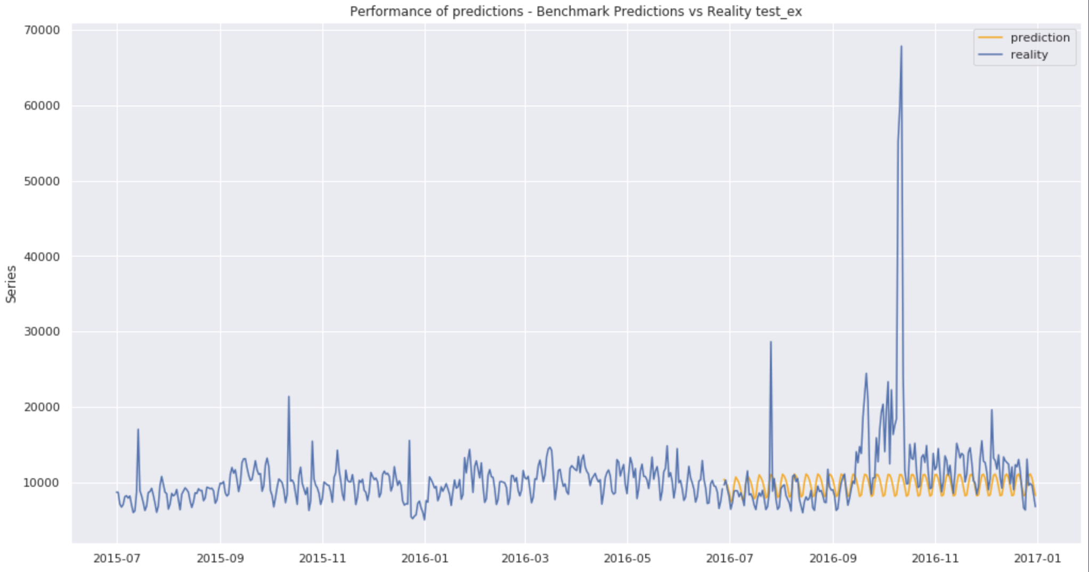
ARIMA
Actual vs Fitted
Forecast (5 months)
Notes:
Here on the right is actual vs fitted with a smape around 19% our model performs well for the fitted values but no so much when we are trying to forecast in the future but does a good job at capturing over all trend

Slide 9
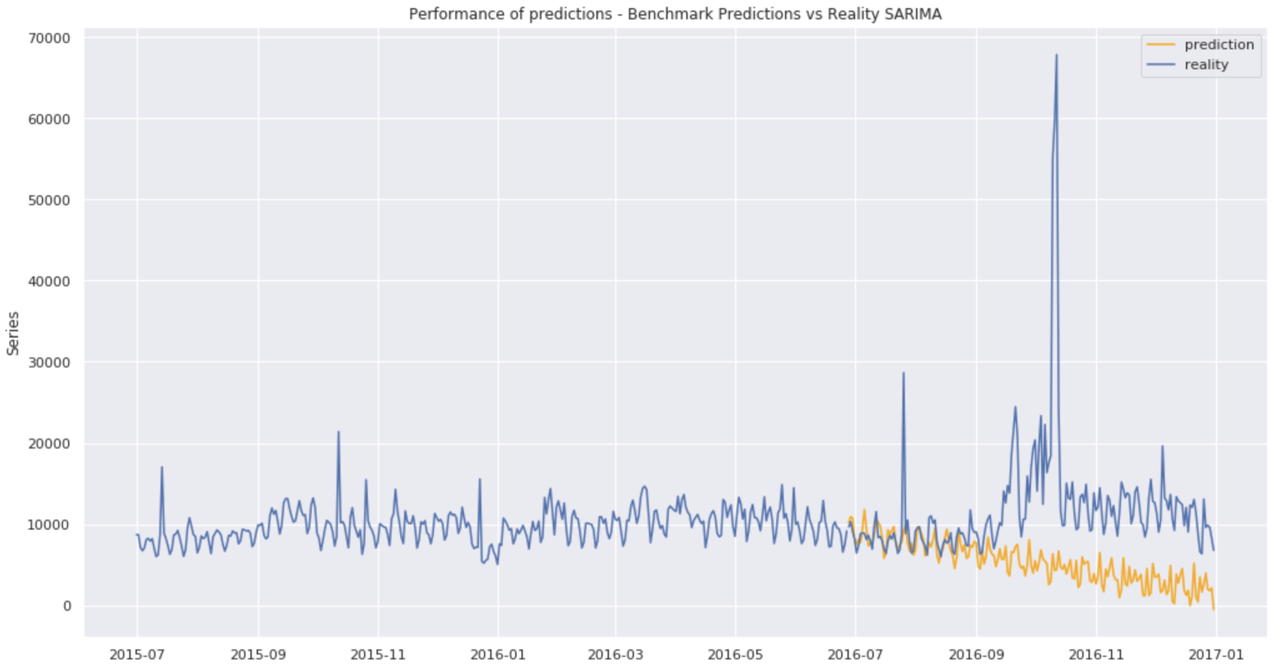
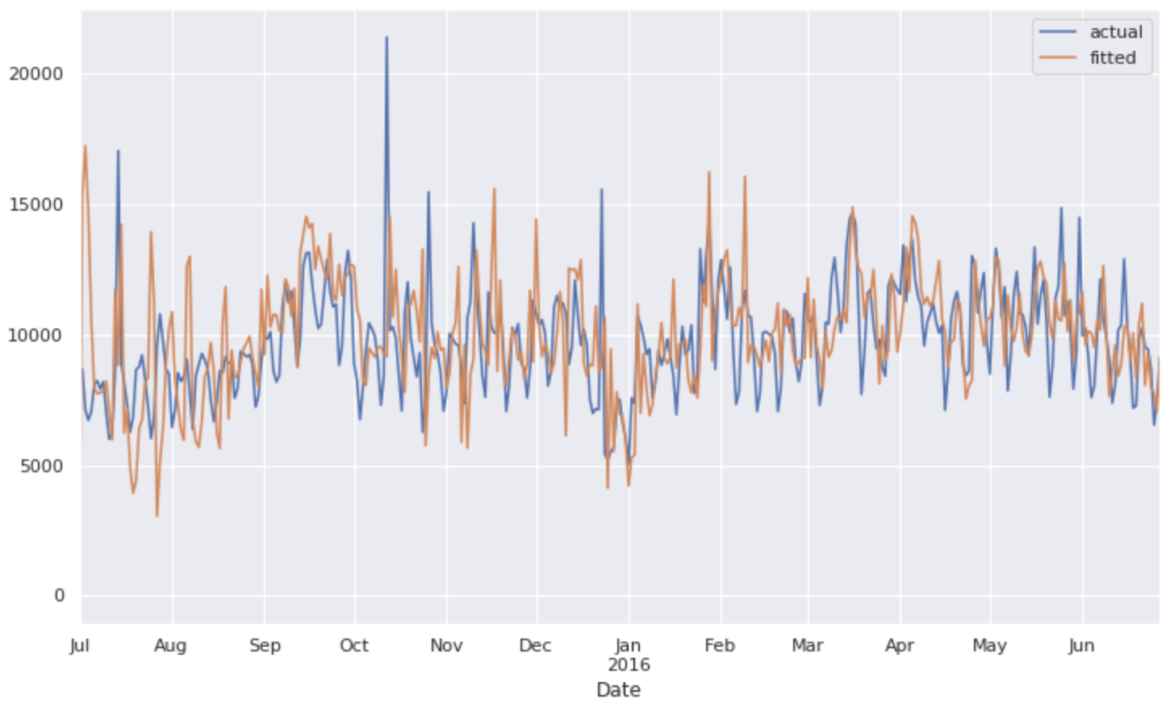
SARIMA
Gridsearch to find best Seasonal parameters
Actual vs fitted
Forecast (5 Months)
Notes:
As arima does not handle seasonal components well i used sarima,
to find the best seasonal parameters I ran a grid search and selected those parameters with the lowest aic score
Sarima does a good job at capturing spikes however when we are forecasting the model performs good initially but eventually moves way towards zero away from the ground truth

Slide 10
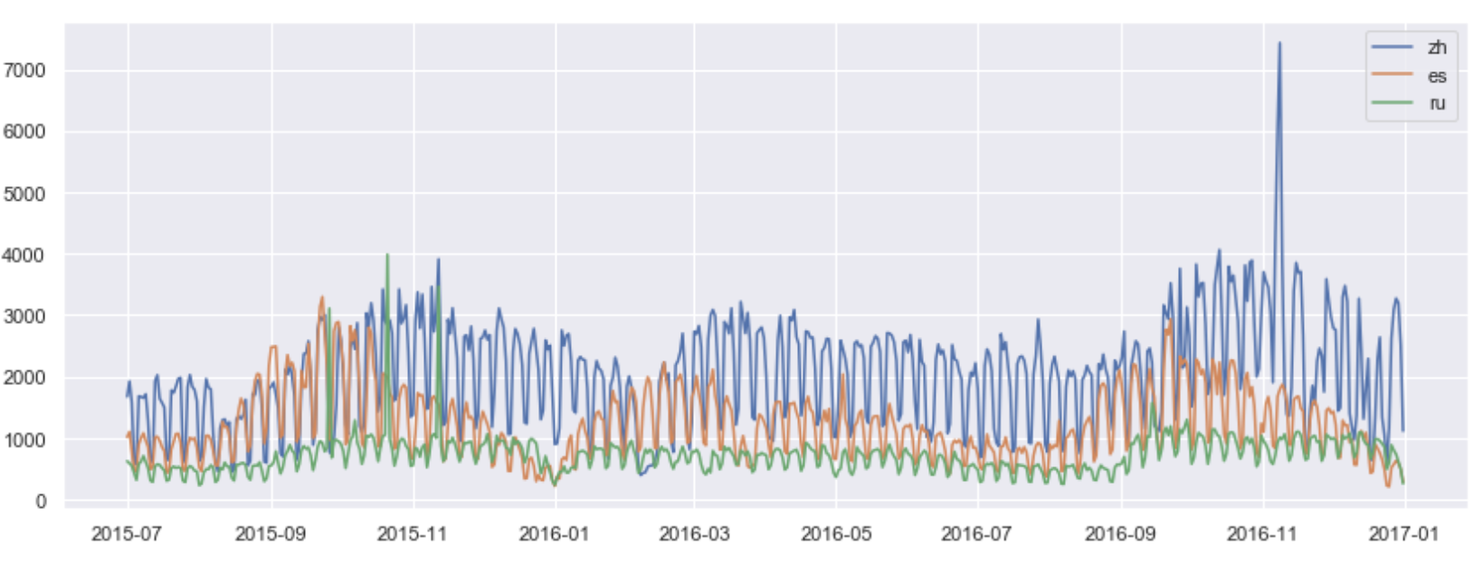
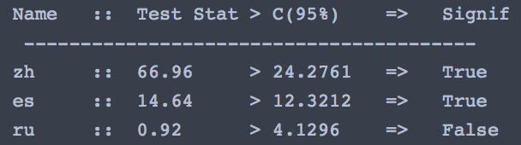
Vector Autoregression (VAR)
Series
granger causality tests
cointegration test
Augmented Dickey-Fuller
Lag Order Selection
Notes:
This chart on the right is the data from the same page but In three different languages that brings the question is there any relationship between these 3 variables this is where vector auto regression comes in we use var when there is multi directionality between the time series
We start with granger causality test to check the p value here we are checking the values at a 95% confidence interval then again we check for statistical significance using co integration test then adf for stationarity and finally select the lag order using a combination of aic bic fpe values

Slide 11
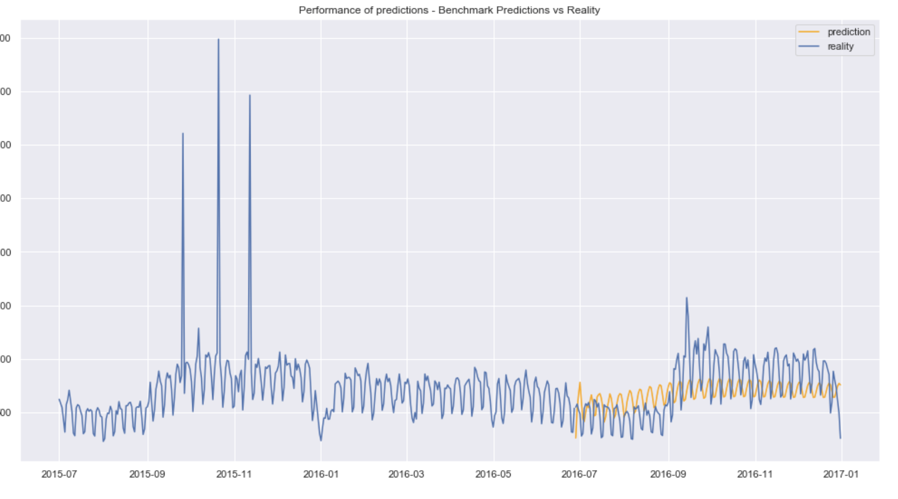
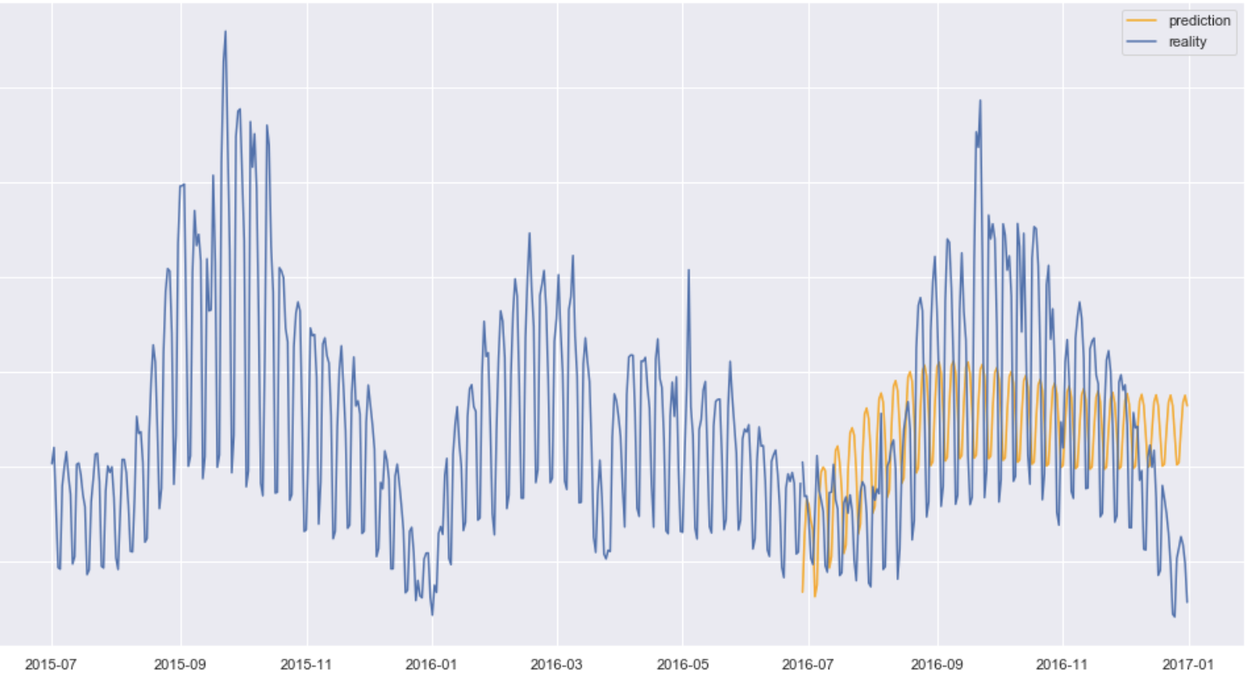
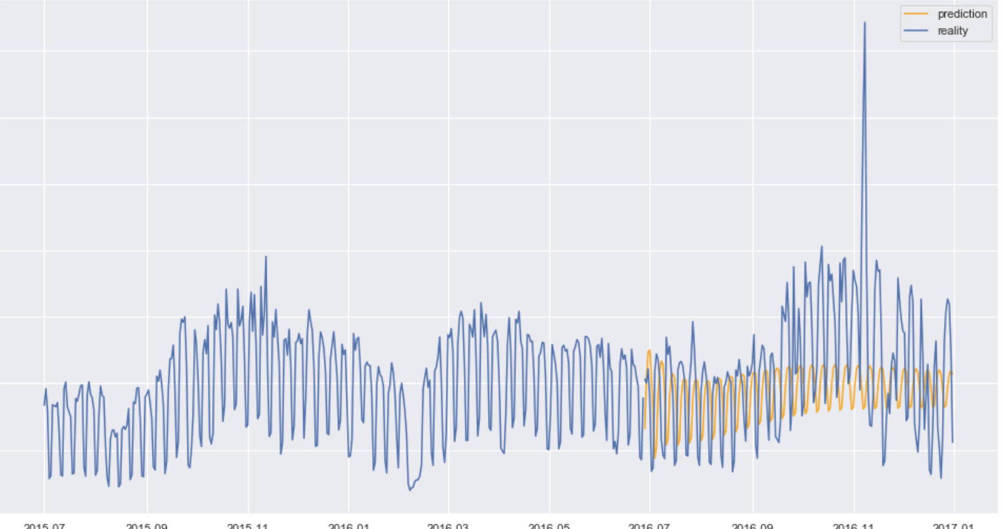
Var results
Notes:
This is how var performs a very stable prediction this has a smape of around 45%

Slide 12
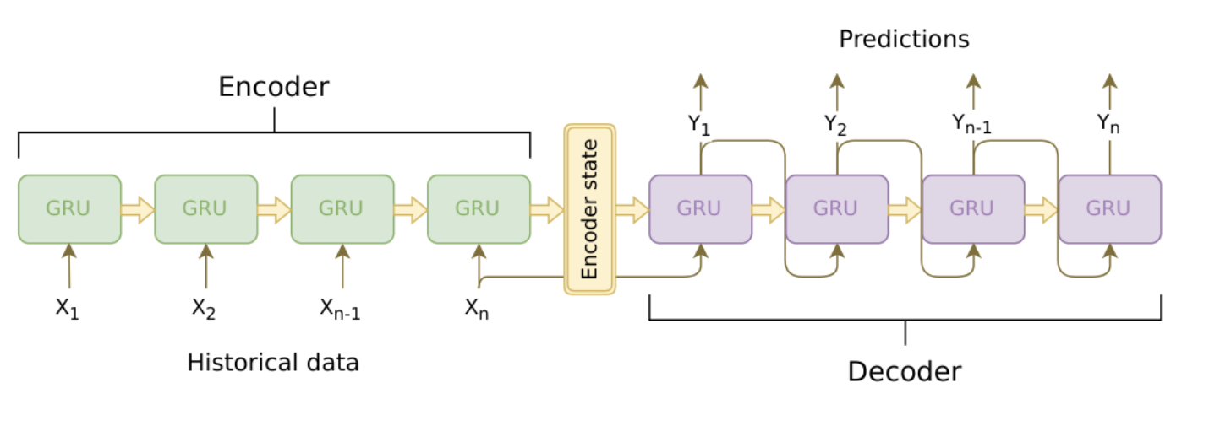
Seq2Seq (using LSTM)
18th Dec,16 –31st Dec,16
1st July,15 –3rd Dec,16
4th Dec,16 –17th Dec,16
LSTM
LSTM
LSTM
LSTM
LSTM
LSTM
LSTM
LSTM
Optimizer :ADAM
Notes:
Now for my final model I used SEQ2SEQ I just want to give an over view on how I ma using this model The model uses an “encoder-decoder” framework
On a very high level the encoder takes in a input sequence and the enoder stat acts as a representation of the entire history of the sequence that provides the context the decoder needs to generate an output sequence.
How I am using this model is that I am training my encoding data from 1 st July2015 to 3 dec 2016 and then I am training my predictions from 4 dec,16 to 17 dec and then finally I am predicting 14 days in the future from 18 to 31 st December

Slide 13
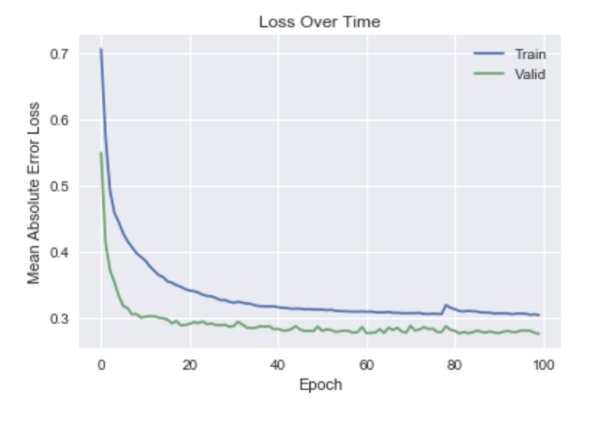
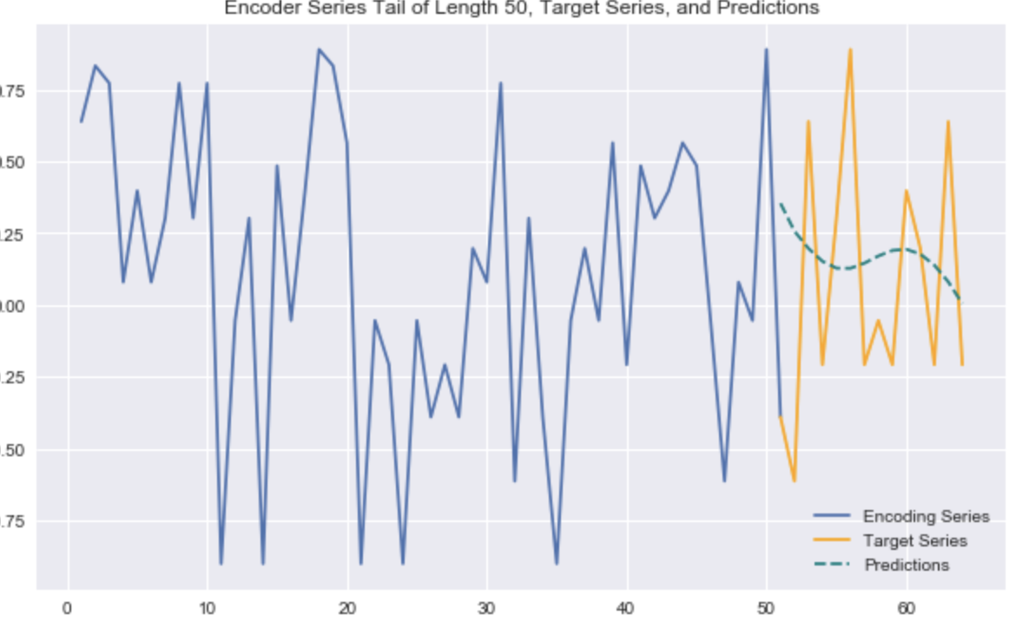
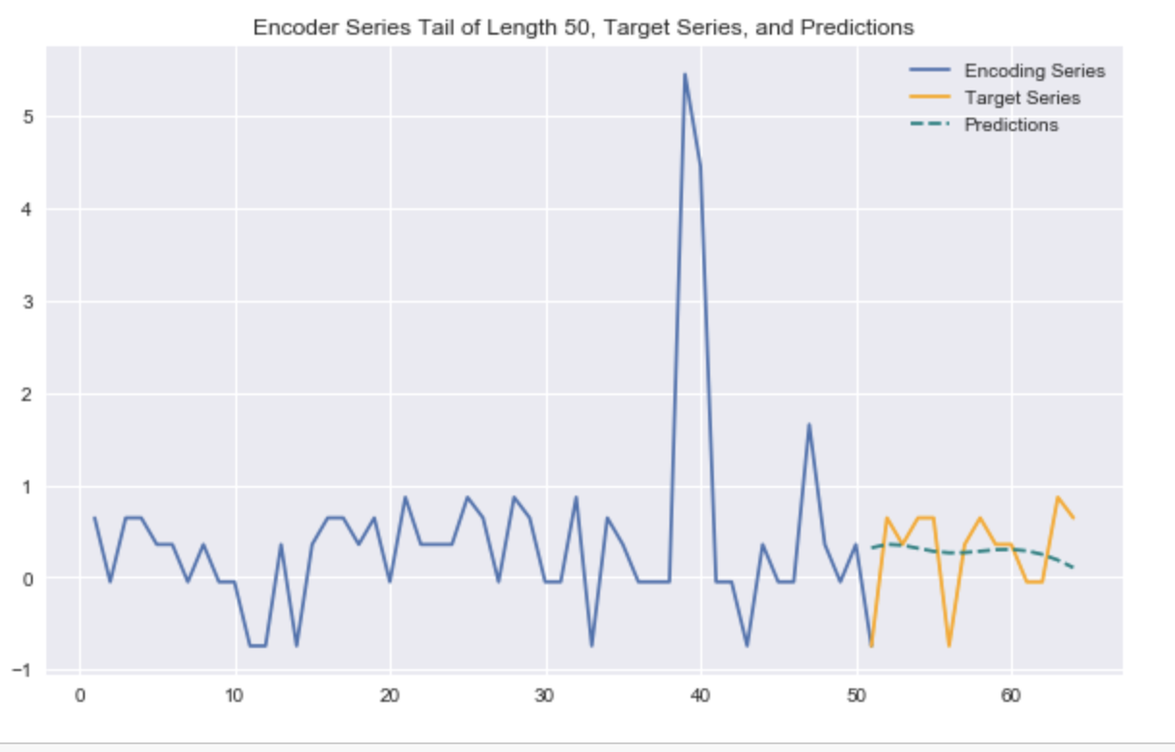
Seq2Seq Results
Notes:
Even though the learning curve is good the model only gives stable but mediocre predictions

Slide 14
Conclusions
Each model has its own strengths and weakness
SARIMA does a good job at explaining Variability at short durations
Seq2Seq gives a very stable prediction (less Variability)
Multiplicative model can be used as good Base line
Arima can be used to capture Trend
VAR can be used in case of Multi Directionality
Seq2seq Architecture is extremely flexible
Notes:
Seq2seq has a very flexible architecture and have a lot of paramters to tune so I feel this model specifically has a lot of potential compared to other with limited features

